Slide 1





Main Results Presentation
at AHA / ASA International Stroke Conference
Houston, 22 February 2017
Craig Anderson MD PhD
On behalf of the Steering, Operations and Advisory Committees
for Investigators and Coordinators across 114 hospitals in 9 countries
Main funding support
Other funding support
An international collaborative project

Slide 2
Disclosures
Grant support from National Health and Medical Research Council (NHMRC) of Australia
Reimbursement from Takeda China and Boehringer Ingelheim for speaker fees and travel expenses

Slide 3
Background to HeadPoST
Lying-flat (or head-down) position suggests benefits in small non-randomized studies of acute stroke
  - ↑blood flow, perfusion, and oxygenation
Concerns over harms - lying-flat may increase risks of pneumonia and cardiorespiratory dysfunction
Sitting-up (or head-up) may reduce cerebral edema in large strokes – as in patients with head injury
Variable positioning in practice
  common in low resource settings
  influence of transcranial Doppler data and guidelines

Slide 4
AHA/ASA Guidelines for the Early Management of Patients with Acute Ischemic Stroke*
“in nonhypoxic patients able to tolerate lying flat, a supine position is recommended”
and
“patients at risk for airway obstruction or aspiration and those with suspected elevated ICP should have the head of the bed elevated 15° to 30°
but
“The ideal position of a stroke patient to optimize these parameters, however, is unknown, and the clinician must balance often competing interests, as well as patient tolerance.”
*Jauch EC, Saver JL, Adams Jr HP, et al.. Stroke 2013; 44: 870-947

Slide 5
HeadPoST aims
To determine benefits and risks of lying-flat vs. sitting-up (≥30 degrees) head positions
- applied early and continued for 24 hours
- broad range of hospitalized stroke patients

Slide 6
Study Outline:
Protocol & analysis plan - published Trials (2015) + Int J Stroke (2017)
Patients: Acute stroke, ‘uncertainty principle’ - no clear indication/contraindication to either position, for 24 hrs
Design: international, multicenter, cluster crossover clinical trial; central blind telephone outcome assessment
Primary outcome – ‘unadjusted’ shift in mRS scores at 90-days
Secondary outcomes – adjusted shift mRS, binary (0-2 vs 3-6) mRS, EQ-5D, LOS hospital at 90-days; shift categorical NIHSS+death (7-levels) and shift mRS at 7-days
Safety outcome – SAEs including pneumonia
Subgroups - several pre-specified
Notes:
6

Slide 7
Design - sample size and statistics
Hospital centers
Randomization
Standard nursing + medical care
Lying-flat ( 0⁰)
Sitting-up ( ≥30⁰)
Crossover
Crossover
Sitting-up ( ≥30⁰)
Lying-flat ( 0⁰)
Blinded outcome assessment at 90 days
70 patients per cluster (n=140) across 140 centers - 16,800 pts (14,000 AIS + 2,800 ICH)
90% power (α 0.05) - detect ≥16% (shift) effect in outcome, ordinal logistic regression
Conservative assumptions: 10% drop-out, 5% crossover, 10% lost-to-follow-up of patients, at each center; ICC (relation of clusters) 0.03, no IPC (relation of treatment periods per cluster)
Notes:
7

Slide 8


HeadPoST network – 11,094 patients recruited from 114 centers between March 2015 and August 2016
INTERACT2 clinical network
UK (41 sites, 4160 pts)
China (39 sites; 4479 pts)
Taiwan (5 sites; 173 pts)
India (6 sites; 499 pts)
Colombia (1 site, 38 pts)
Sri Lanka (4 sites; 271 pts)
Brazil (4 sites, 264 pts)
Australia (7 sites, 602 pts)
Chile (7 sites, 608 pts)

Slide 9
Patient Flow
Review of sample size indicates retained 90% power
182 hospitals invited
116 Randomized
57 assigned lying-flat then sitting-up positioning
59 assigned sitting-up then lying-flat positioning
1 not activated
1 not activated
56 lying-flat
56 sitting-up
58 sitting-up
58 lying-flat
6,407 screened
5,371 screened
5,545 screened
5,310 screened
3,562 excluded
930 other condition
567 long delay
528 not stroke
444 TIA
433 refusal
323 rapid transfer
51 other research
40 rapid death
13 prior participant
1 <18 yr
232 other reasons
2,604 excluded
430 other condition
452 long delay
492 not stroke
323 TIA
240 refusal
469 rapid transfer
15 other research
37 rapid death
26 prior participant
120 other reasons
2,513 excluded
349 other condition
398 long delay
442 not stroke
358 TIA
294 refusal
332 rapid transfer
32 other research
40 rapid death
17 prior participant
1 <18 yr
250 other reasons
2,860 excluded
570 other condition
374 long delay
474 not stroke
399 TIA
338 refusal
438 rapid transfer
12 other research
21 rapid death
17 prior participiant
217 other reasons
2,845 included
2,767 included
3,032 included
2,450 included
344 excluded
370 excluded
367 excluded
277 excluded
2,501 (88%) for analysis
2,397 (87%) for analysis
2,665 (88%) for analysis
2,173 (89%) for analysis

Slide 10
Characteristics of hospitals
 | Lying-flat/Sitting-up (N=57) | Sitting-up/Lying-flat (N=59)
Australia | 2 (4%) | 5 (9%)
Brazil/Chile/Columbia | 7 (12%) | 5 (9%)
China/Taiwan | 22 (40%) | 23 (39%)
India/Sri Lanka | 4 (7%) | 6 (10%)
UK | 21 (37%) | 20 (34%)
Public | 54 (95%) | 56 (95%)
Private | 3 (5%) | 3 (5%)
Metropolitan/urban | 43 (75%) | 44 (75%)
Semi-metropolitan/semi-urban | 13 (23%) | 12 (20%)
Rural/countryside | 1 (2%) | 3 (5%)
Teaching hospital | 47 (83%) | 49 (83%)
Number of strokes per year
<500 | 17 (30%) | 21 (37%)
≥500 | 39 (70%) | 37 (63%)

Slide 11
Baseline - Demographic and clinical
Variable | Lying-flat N=5295 | Sitting-up N=5798
Age, mean | 68 | 68
Female | 40% | 40%
Aust/UK | 42% | 44%
Hypertension | 51% | 51%
Prior stroke | 23% | 24%
Diabetes | 20% | 20%
Blood pressure, mean | 155/87 | 155/87
NIHSS median (iqr) score | 4 (2-9) | 4 (2-9)
Time from stroke onset, median (iqr), hr | 14 (5–35) | 14 (5-25)
Thrombolysis, rtPA | 12% | 12%
Notes:
Done

Slide 12
Baseline characteristics – stroke subtype
Variable | Lying-down (N=5298) | Sitting-up (N=5798)
Stroke mimic | 4% | 6%
TIA | 2% | 2%
Acute ischemic stroke | 86% | 85%
Large artery occlusion | 31% | 32%
Small vessel ‘lacunar’ | 30% | 31%
Cardioemboli | 13% | 13%
Other uncertain | 26% | 25%
Acute intracerebral hemorrhage | 8% | 9%
Notes:
Done

Slide 13
Adherence to intervention
 |  |  | Lying-flat (N=5295) | Sitting-up (N=5798) | Odds ratio/Mean difference (95% CI) | P value
Time spent in allocated position - hr
Median (iqr) |  |  | 23 (20-24) | 24 (23-24) | -1.6 (-2.1 to -1.2) | <0.0001
Intervention discontinued - n (%) | 695 (13) |  |  | 245 (4) | 4.0 (3.1 to 5.3) | <0.0001
Not tolerated | 201 (29) |  |  | 21 (9)
Unable to comply | 73 (11) |  |  | 11 (5)
Patient preference | 135 (19) |  |  | 37 (15)
Doctor preference | 35 (5) |  |  | 5 (2)
Change in medical condition | 85 (12) |  |  | 11 (5)
Other | 166 (24) |  |  | 158 (65)
Not specified |  |  |  | 2 (1)

Slide 14
Results

Slide 15
Primary clinical outcome
Death or disability (mRS 2-6) at 90 days
Unadjusted | Odds ratio 1.01 (95%CI 0.92 to 1.10) | P=0.84
Adjusted baseline demographic variables | Odds ratio 1.05 (95%CI 0.96 to 1.15) | P=0.30
Adjusted baseline demographic + risk factors | Odds ratio 1.03 (95%CI 0.94 to 1.13) | P=0.55
Adjusted with imputation | Odds ratio 1.03 (95%CI 0.94 to 1.13) | P=0.50
Not significant for acute ischemic stroke or intracerebral hemorrhage

Slide 16
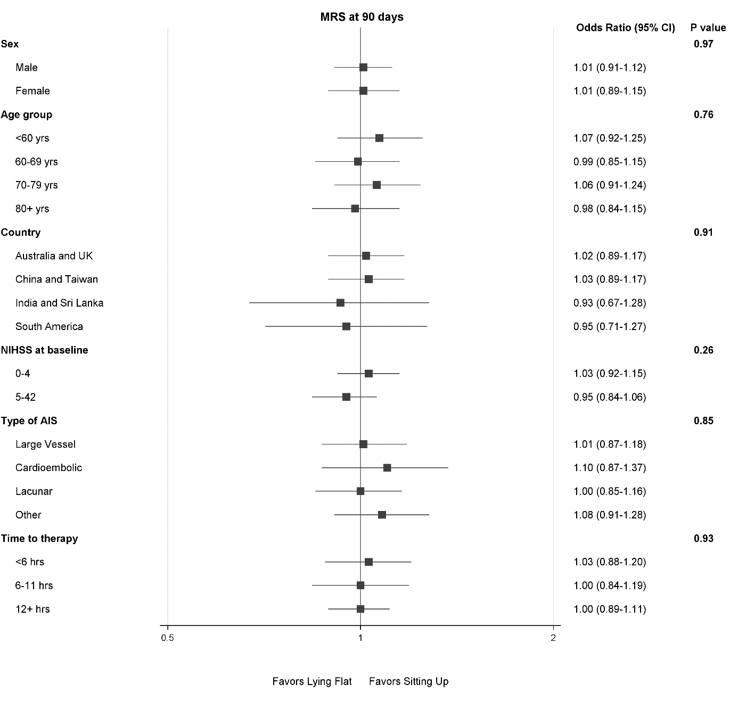
HeadPoST
Subgroup of
Primary outcome shift-mRS at 90 days

Slide 17
Other secondary outcomes
Outcome | Lying-down | Sitting-up | Odds Ratio | P
Death/dependency: mRS 3-6 | 39% | 40% | 0.94 | 0.25
Death at 90 days | 7% | 7% | 0.98 | 0.83
mRS shift at 7-days |  |  | 1.02 | 0.67
NIHSS+death (7-categories, shift) |  |  | 0.98 | 0.71
Hospital LOS, median (iqr), days | 9 (4-15) | 9 (4-15) | 0.99 | 0.70
EQ-5D VAS | 73 | 72 | -1.4 | 0.01
SAE | 14% | 14% | 1.05 | 0.51
Pneumonia | 3% | 3% | 0.86 | 0.19
Notes:
Done

Slide 18
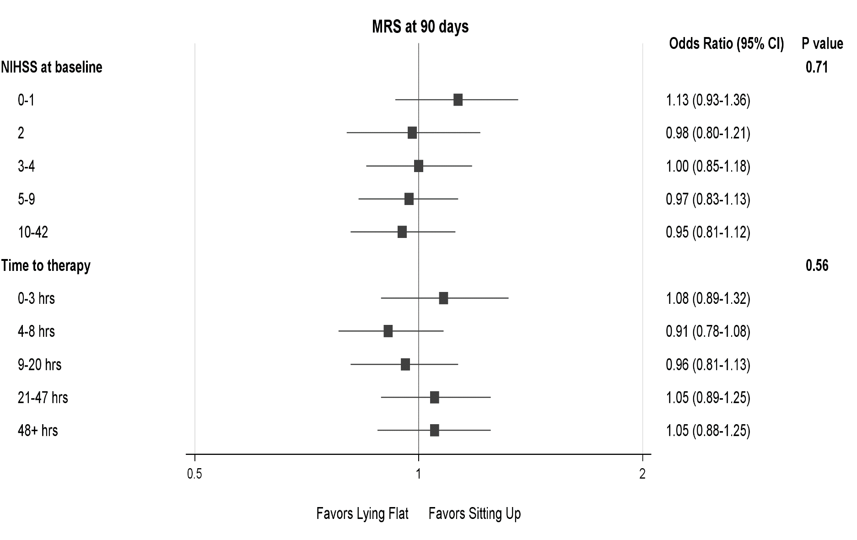
Post-hoc analysis of the Primary outcome - by quintiles of baseline NIHSS and Time to treatment
Notes:
Done

Slide 19
Summary of findings

Slide 20
Strengths & Weakness
Strengths
Simple nursing care intervention evaluated on a large scale
Pragmatic - generalizability of these data
Power to evaluate a plausible, minimally clinically worthwhile treatment effect
Central randomization and rigorous outcome assessment
Pre-specified statistical analysis
Good adherence to protocol and intervention
Weaknesses
Most participants had mild-moderate strokes
Most participants presented late
‘Open’ design (PROBE) → potential bias and confounding

Slide 21
Major findings of HeadPoST
Successful completion of a novel ‘cluster crossover’ design to evaluate a nursing management strategy
In acute stroke patients, positioning either lying-flat or sitting-up in the first 24 hours of hospitalization:
Lying flat is uncomfortable
No differences in effects on disability outcome
Positioning is safe - no differential SAEs or pneumonia
No clear benefits (or harms) in subgroups according to:
  time from onset of symptoms
  initial stroke severity
  age
  region
  AIS vs. ICH / subtype of ischemic stroke

Slide 22
Implications for Clinicians
No clear benefits (or harms) of specific head positioning in acute stroke
Review of guideline recommendations

Slide 23





Special thanks
Steering Committee
Gillian Mead (Chair) - Centre for Clinical Brain Sciences, Univ. Edinburgh, UK
Maree Hackett (PI), Craig S Anderson (Co-PI), Laurent Billot - The George Institute for Global Health, Sydney, Australia
Pablo M Lavados, Veronica V Olavarria - Servicio de Neurología, Clínica Alemana de Santiago, Univ. del Desarrollo, Santiago, Chile
Sandy Middleton - St Vincent's Health Australia (Sydney) and Australian Catholic Univ., Sydney, NSW, Australia
Caroline Watkins - School of Health, Stroke Practice Research Unit, Lancashire Clinical Trials Unit, Univ. Central Lancashire, Preston, UK
Tom Robinson – Dept. Cardiovascular Sciences, Univ. Leicester British Heart Foundation Cardiovascular Research Centre, Leicester, UK
Hisatomi Arima (Co-PI) – Dept. Preventive Medicine and Public Health, Faculty of Medicine, Fukuoka Univ., Fukuoka, Japan
H. Asita De Silva - Dept Pharmacology, Faculty of Medicine, Univ. Kelaniya, Colombo, Sri Lanka
Jeyaraj Pandian - Dept. Neurology, Christian Medical College and Hospital, Ludhiana, India
Ruey-Tay Lin - Dept. Neurology, Kaohsiung Medical Univ. & Hospital, Kaohsiung, Taiwan
Tsong-Hai Lee - Dept. of Neurology, Linkou Chang Gung Memorial Hospital, Taipei, Taiwan
Liying Cui, Bin Peng - Peking Union Medical College Hospital, Beijing, PR China
Octavio Pontes-Neto - Ribeirao Preto School of Medicine Univ. São Paulo, Ribeirão Preto, Brazil
Joyce Lim, Global Project Manager, The George Institute Australia
Patients and families, committees, research monitors and coordinators

